Slide 1
Regression Analysis Project Agri-food sector
Produced By: Glen Adams, Tyrelle Brandt, Tim Fleur, Sharon Rangwato & Muhammad Seedat

Slide 2
Table of contents
01
02
03
04
Overview
EDA
Project Overview and objectives
Exploratory Data Analysis
Models
Conclusion
Regression Models
You can describe the topic of the section here

Slide 3
01
Overview

Slide 4
Purpose
Analyse FAO and IPCC data on GHG emissions from the agri-food sector to understand its impact and develop climate change mitigation strategies.

Slide 5
Key Data Components
Farm Gate Emissions: Direct emissions from agricultural activities.
Land-Use Change: Emissions from deforestation and land conversion.
Pre- and Post-Production Processes: Emissions from food manufacturing, transportation, retail, and waste disposal.

Slide 6
Global Trends
2020: Agri-food systems emissions were 16 billion tonnes CO2eq (31% of total GHG emissions).

Slide 7
Regional Variations
Oceania: 71% farm-gate emissions.
Asia: 50% farm-gate emissions.
Africa: 44% land-use change emissions.
Europe: 53% pre- and post-production emissions.

Slide 8
Mitigation and Adaptation
Transform agri-food systems with climate-smart practices, better water management, and reduced food waste.

Slide 9
Data Analysis Approach
Data Preparation:
Exploratory Data Analysis (EDA):
Modelling and Evaluation:
Conclusion and References:
Importing Packages, Loading Data, and Data Cleaning.
Visualizations and summary statistics.
Feature Engineering, Modelling, and Model Performance.
Summary of findings and sourcing information.

Slide 10
Project Objective and goals
Understand the impact of agricultural activities on climate change.
Develop strategies for sustainable practices.
Use a comprehensive dataset from FAO and IPCC.
Explore various emission sources.
Perform regression analysis to predict temperature variations.
Offer actionable insights for stakeholders.

Slide 11
02
EDA
Exploratory Data Analysis

Slide 12
Approach
Exploratory Data Analysis (EDA) is the process of examining datasets to summarise their main characteristics. It often involves visualisations and summary statistics to uncover patterns, identify anomalies, and test hypotheses.

Slide 13
About the data
The dataset “co2_emissions_from_agri” was collected from FAO and IPCC.
Emissions from the agri-food sector significantly contribute to global annual emissions.
Understanding and addressing these emissions is crucial for mitigating climate change and promoting sustainability.
The dataset includes various emission sources such as savanna fires, forest fires, crop residues, and rice cultivation.
It also covers pesticide manufacturing, food transport, and food processing emissions.
Features include total emissions, average temperature increase, and population data.
Forestland is noted for its harmful emissions due to its role as a carbon sink. And the most important thing: the audience won’t miss the point of your presentation

Slide 14
Data Characteristics
The Dataset contains :
6965 rows
31 columns, of which:
Area is type object (categorical)
Year is type int64 (categorical, time series)
Remaining 29 columns are type float64 (numerical)
Several columns have a Non-null Count < 6965

Slide 15
Data Cleaning Analysis
Noted the following during the analysis
Column names have a mixed case and will need renaming
Need to understand units of measurement for different columns, non-standardised data
Some columns with zero values - drained organic soils, net forest conversion, fires in organic soils, fires in humid tropical forests
There are several features below for which there is not enough data (more observations have zero values than not) :
Drained_organic_soils
fires_in_organic_soils,
Fires_in_humid_tropical_forests))
Eleven of the 29 numeric columns contain nulls.
Duplicated data was noted in our analysis for China vs China Mainland.

Slide 16
Data Cleaning Actions
Column names have been standardised as follows:
Lower snake case
remove units of measurement like degrees celsious or co2
remove dashes ‘-’
These features were dropped:
drained_organic_soils
fires_in_organic_soils
fires_in_humid_tropical_forests
Updated the null values to zero
Removed China from our model analysis & kept China, Mainland

Slide 17
Data Cleaning Actions
Correlation analysis of independent variables highlighted the following for removal
manure_management (correlated with manure_applied_to_soils)
food_packaging (correlated with food_household_consumption, food_processing)
food_processing (correlated with food_packaging, food_household_consumption)
total_population_male (total_population_female)

Slide 18
03
Models
Vizualisation of models used in EDA

Slide 19
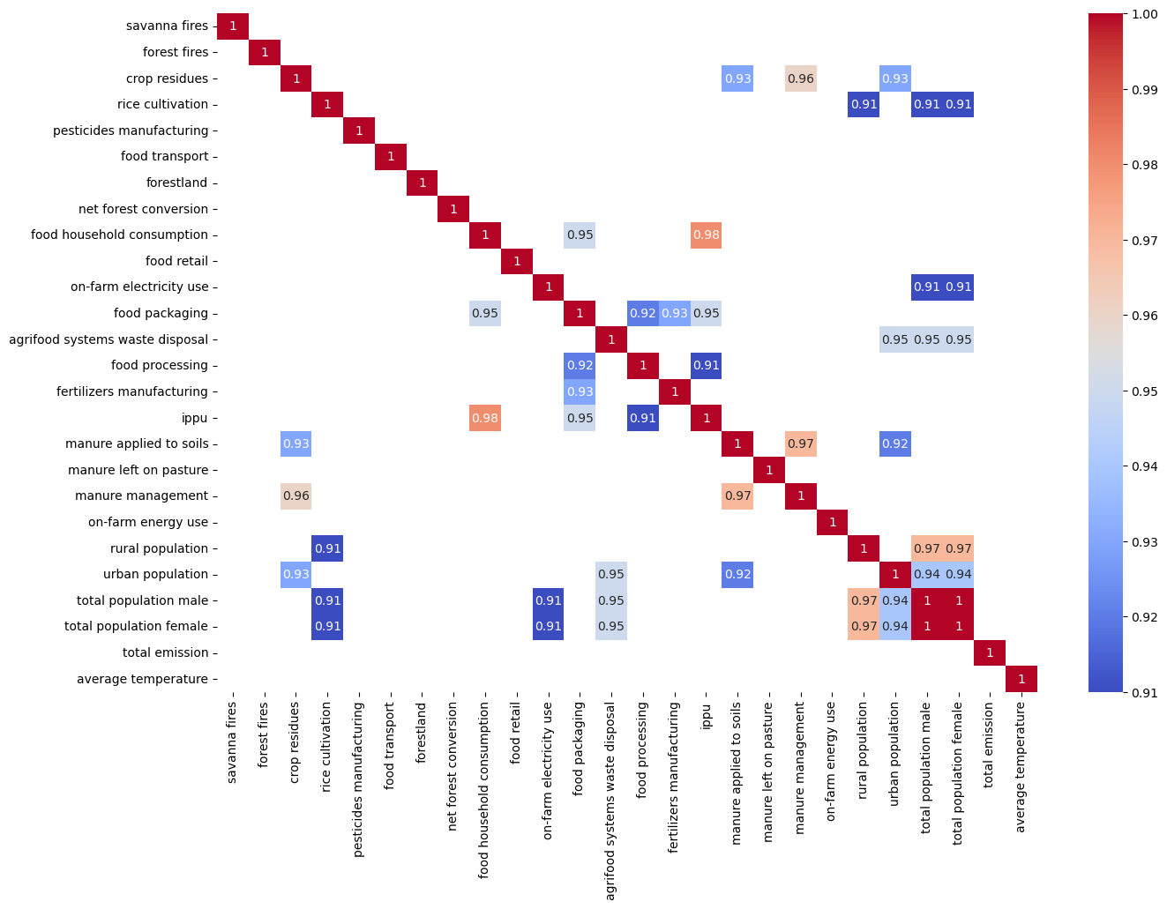
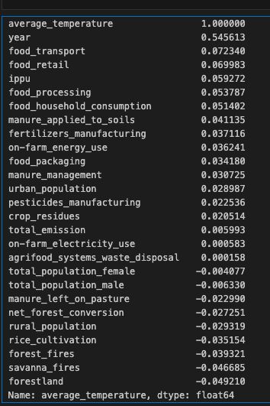
Correlation Matrix with Threshold

Slide 20
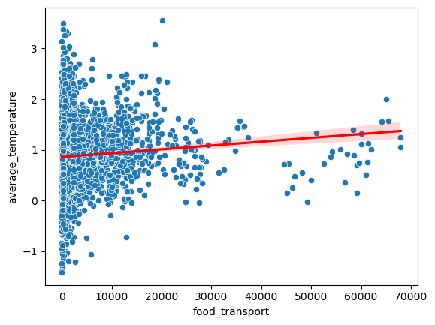
Regression Plot

Slide 21
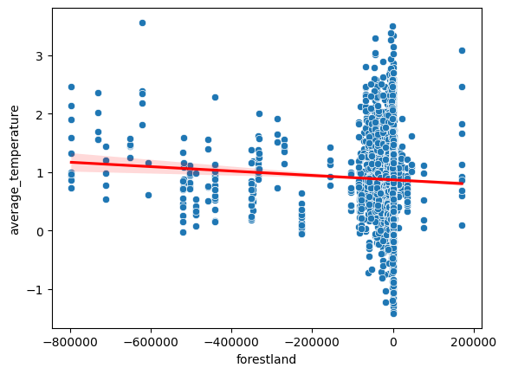
Regression Plot

Slide 22
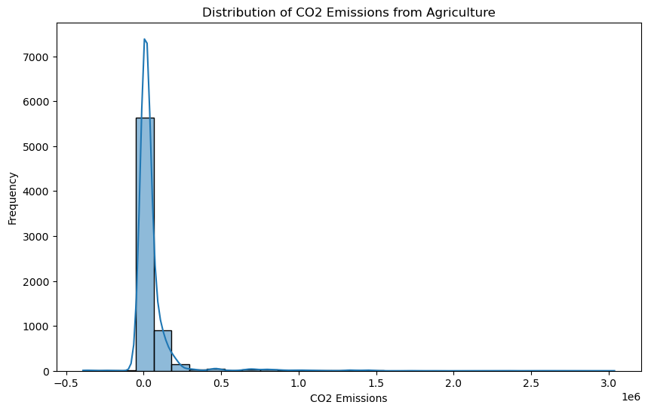
Histogram of C02 emissions

Slide 23
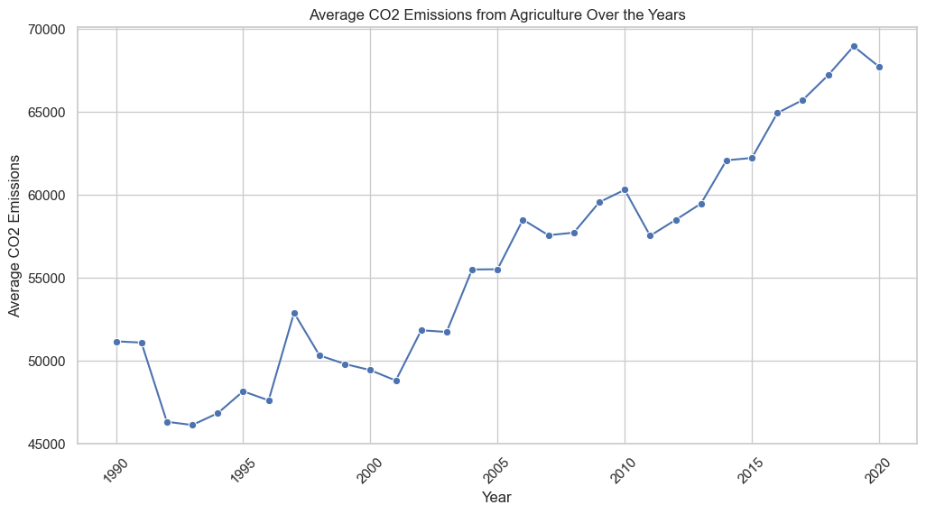
Line Plot

Slide 24
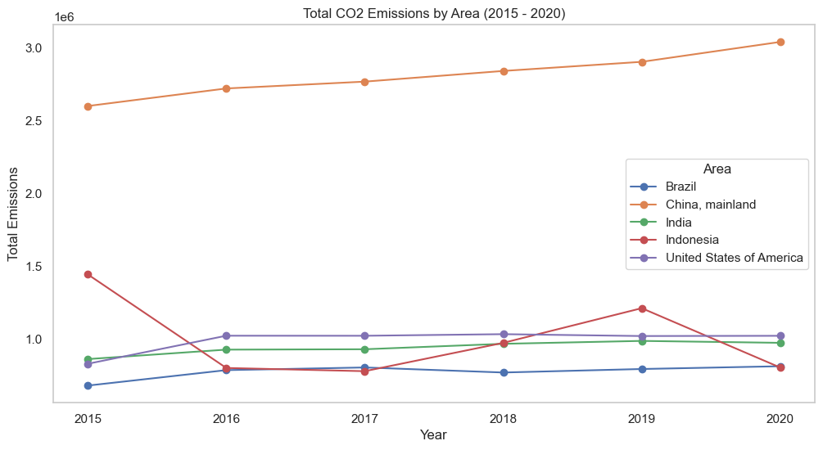
Combination Line Plot

Slide 25
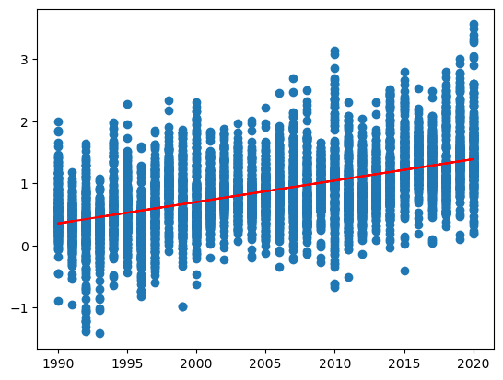
Linear Regression Models
Average Temperature vs Years
MSE: 0.20458
RMSE: 0.45231
Residual sum of squares: 283.75831
R_squared: 0.2964

Slide 26
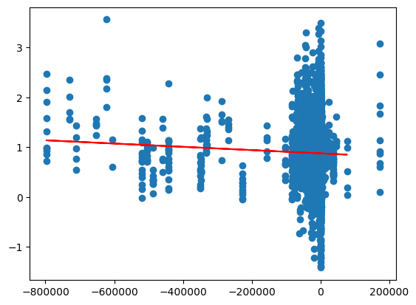
Linear Regression Models
Average Temperature vs Forestland
MSE: 0.2911
RMSE: 0.53953
Residual sum of squares: 403.75017
R_squared: -0.00113

Slide 27
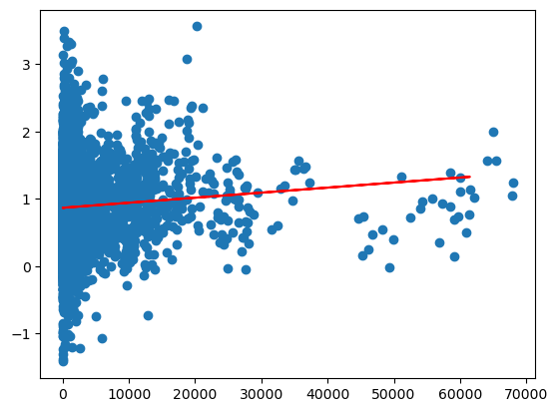
Linear Regression Models
Average Temperature vs Food Transport
MSE: 0.29093
ResidualRMSE: 0.53938
sum of squares: 403.52053
R_squared: -0.00056

Slide 28
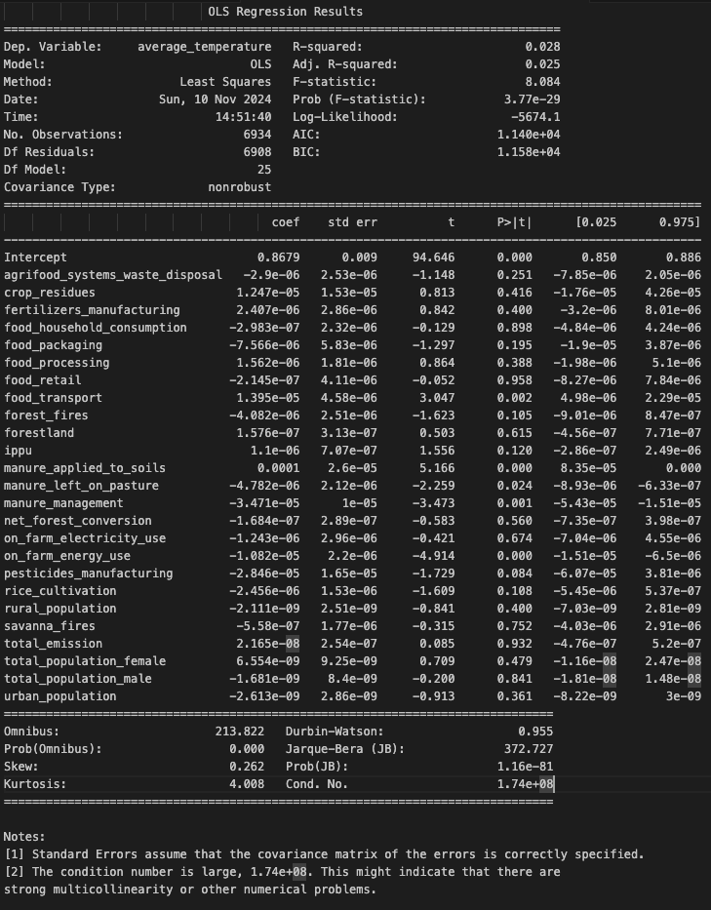
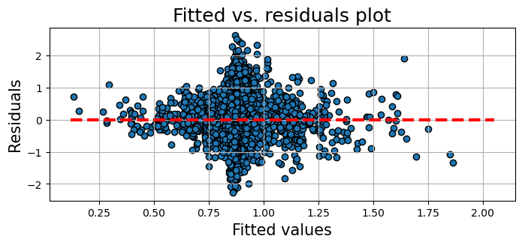
OLS Regression

Slide 29
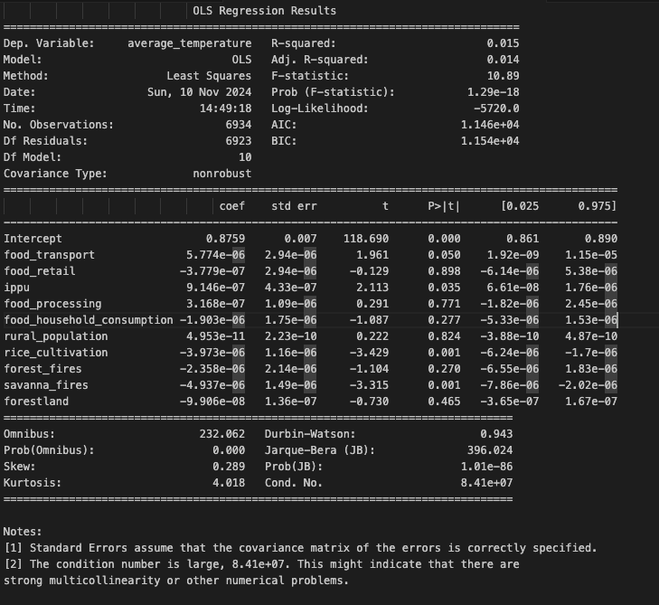
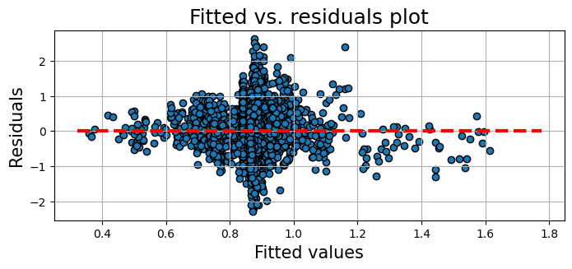
OLS Regression Reduced Features

Slide 30
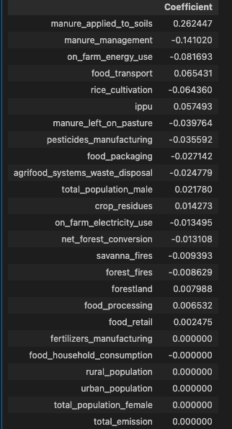
Lasso
LASSO regression for regularisation revealed some variables contributing strongly to the model result:
manure_applied_to_soils
manure_management
on_farm_energy_use
food_transport
rice_cultivation
The low r-squared value (0.02), indicating a linear model not suited to the data.

Slide 31
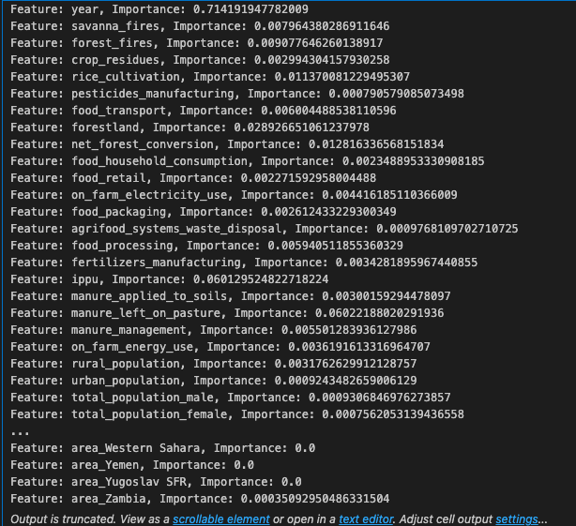
Random Forest
Increasing the model max depth from 5 to 14 resulted in large improvements in the r-squared value (0.58).
As the model could be overfitting on the dataset, random sampling and hyper parameter tuning was done using Randomized Search Cross Validation
Best parameters found: {'n_estimators': 150, 'min_samples_split': 2, 'min_samples_leaf': 1, 'max_features': 'sqrt', 'max_depth': 15, 'bootstrap': False}
Best R-squared score: 0.3184695672214627

Slide 32
SVR and XG Boost
The Support Vector Regressor (SVR) Model was used with an RBF Kernel suited to non-linear relationships.
RMSE: 0.40208
R-squared: 0.46613
XG Boost performed slightly better on the same dataset:
RMSE: 0.39275
R-squared: 0.46949

Slide 33
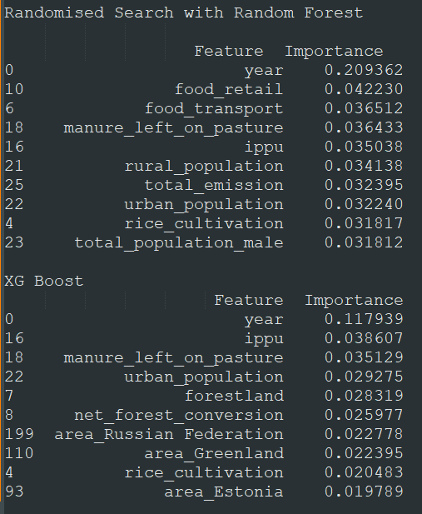
Feature Importance
Both the Random Forest and XG Boost models highlighted emissions from industrial processes (ippu), manure left on pasture and rice cultivation as more significant contributors to the prediction of average temperatures.
XG Boost also emphasised the contribution of large land masses like Russia, Greenland and Estonia to the target variable

Slide 34
04
Conclusion

Slide 35
Summary
Data Preparation: Standardized column names, removed units of measurement, and handled null values.
Feature Exclusion: Excluded irrelevant features like drained_organic_soils, fires_in_organic_soils, and fires_in_humid_tropical_forests.
China Data Handling: Excluded China but retained China, Mainland for analysis.
Correlation Analysis: Found very weak correlations between features (except year) and the target variable (average temperature).
EDA Findings: Identified a weak linear relationship between year and average temperature.
Model Performance: Simple Linear Regression model showed inadequate performance for temperature prediction. Non-linear models (Random Forest, SVM, XG Boost) performed better and provided insights.
Recommendations: Refine data collection, set clear objectives, adopt advanced models, and continuously reassess methodology.

